Slide 1
Biosimilars in Oncology and Hematology: A Brave New World of Cancer Treatment
How Do We Incorporate Biosimilars into Breast Cancer Care?
Francisco J. Esteva, MD, PhD
Professor of Medicine, NYU School of Medicine
Director, Breast Medical Oncology
Associate Director of Clinical Investigation
Laura and Isaac Perlmutter Cancer Center
New York University Langone Medical Center

Slide 2
Outline
Introduction (HER2, Trastuzumab)
Biosimilars currently in development for the treatment of breast cancer
Extrapolation between different indications

Slide 3
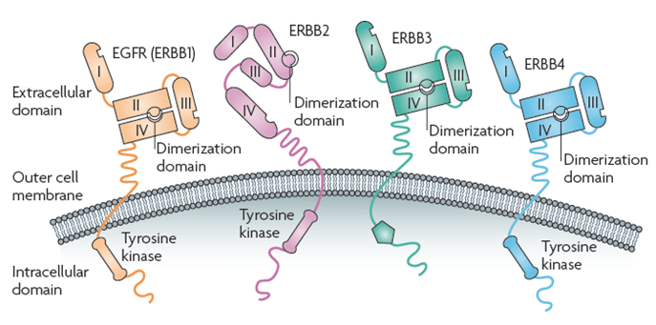
EGF Receptor Family
Worse Survival of Patients With HER2+ Primary Breast Cancer
Baselga & Swain. Nat Rev Cancer 2009;9:463-75
HER2− (n=465)
OS (%)
HER2+ (n=163)
P<0.001
Years
Adapted from Pritchard et al. N Engl J Med 2006;354:2103

Slide 4
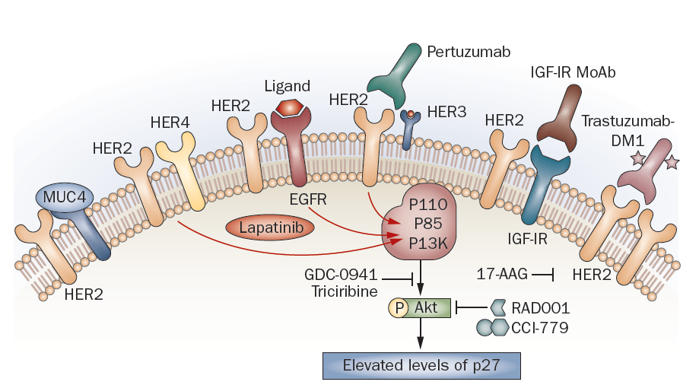
Milestones of HER2 Targeted Therapy in Breast Cancer
1982
1985
1987
1998
2006
2007-2014
2014
neu oncogene discovery Weinberg
FDA approves single agent trastuzumab for 2nd line and in combination with paclitaxel for 1st line MBC
Main trastuzumab patent expires in Europe*
Her2 cloned Schechter, Hung, …, Ullrich, Coussens
Her2 amplification in breast cancer
King, Kraus, Aaronson
FDA approves trastuzumab in adjuvant setting
Trastuzumab
Biosimilars
Amplification of Her2/neu correlates with shorter survival Slamon
FDA approves lapatinib, pertuzumab, trastuzumab-DM1
Innovation
Continues
*www.evidence.nhs.uk
mTOR
Adapted from Esteva FJ, et al. Nat Rev Clin Oncol. 2010;7(2):98-107
Notes:
4

Slide 5
Trastuzumab biosimilars in late phase clinical development for breast cancer
Company name | Product name | Stage of development
Pfizer, USA | PF-05280014 | Phase III trial ongoing
Celltrion, South Korea | CT-P6 | Marketed in South Korea for metastatic breast cancer, following approval in Jan 2014 (Herzuma). Phase III in early-stage breast cancer ongoing
Amgen, USA | ABP-980 | Phase III trial ongoing
Biocad, Russia | BCD-022 | Phase III trial ongoing
www.clinicaltrials.gov, accessed 11/2/14

Slide 6
A Phase I Pharmacokinetics Trial Comparing PF-05280014 and Herceptin® in Healthy Volunteers
In this double-blind, randomized, 3-arm trial, 105 healthy male volunteers aged 18-55 were randomized to receive a single 6 mg/kg dose of PF-05280014, Herceptin-US, or Herceptin-EU
Primary endpoints
Maximum serum concentration (C_{max}) of the administered mAb
Area under the serum concentration-time curve (AUC) from time 0 to the last time point with measurable concentration of the administered mAb (AUC_{T})
Day 0
Days 1-8
Days 9-71
S
C
R
E
E
N
I
N
G
R
A
N
D
O
M
I
Z
A
T
I
O
N
US-sourced
Herceptin
N = 35
EU-sourced
Herceptin
N = 35
Day 1
Study drug administration
Day 2
Discharge from unit
Visit days
15, 22, 29, 43, 71
PF-05280014
N = 35
PK and ADA Sample Collection
Time (hr) post-dose
Day 1
0,1,5,3,8
Day 2
24
Day 3
48
Day 5
96
Day 8
166
Day 15
336
Day 22
504
Day 29
672
Day 43
1008
Day 71
1680
Extended Follow-Up
Up to 6 mos
Yin D, et al. J Clin Oncol. 2013;31(Suppl): Abstract 612.

Slide 7



PF-05280014 Phase I: Pharmacokinetics
Individual and Mean Estimates of C_{max}, AUC_{T}, and AUC_{0-∞} of PF-05280014, Herceptin®-EU, and Herceptin®-US
400
C_{max}
60000
AUC_{T}
60000
AUC_{0-∞}
300
50000
50000
C_{max}g/mL
AUC_{T}g·hr/mL
AUC_{0-∞}g·hr/mL
40000
40000
200
30000
30000
100
20000
20000
PF EU US
PF EU US
PF EU US
AUC_{0-∞}, area under the concentration-time curve from time 0 extrapolated to infinte time; AUC_{T}, area under the concentration-time curve from time 0 to last measurable administered monoclonal antibody; C_{max}, maximum serum concentration; EU, trastuzumab EU; PF, PF-05280014; US, trastuzumab-US
Statistical Comparison of PK Exposure Parameters Between Test and Reference Products
 |  |  | Geometric Mean
Test | Reference | Parameter* | Test | Reference | Ratio, %† | 90% CI, %
PF-05280014 | Trastuzumab-US | C_{max} | 157 | 161 | 97.41 | 90.71-104.62
 |  | AUC_{T} | 35210 | 35230 | 99.94 | 93.08-107.31
 |  | AUC_{0-∞} | 36650 | 36710 | 99.83 | 93.06-107.09
PF-05280014 | Trastuzumab-EU | C_{max} | 157 | 171 | 91.49 | 85.32-98.09
 |  | AUC_{T} | 35210 | 38000 | 92.66 | 86.44-99.34
 |  | AUC_{0-∞} | 36650 | 39770 | 92.15 | 86.03-98.69
Trastuzumab-EU | Trastuzumab-US | C_{max} | 171 | 161 | 106.48 | 99.20-114.30
 |  | AUC_{T} | 38000 | 35230 | 107.85 | 100.50-115.75
 |  | AUC_{0-∞} | 39770 | 36710 | 108.34 | 101.05-116.16
*C_{max}, AUC_{T} and AUC_{0-∞} were in units of g/mL, g·hr/mL, respectively. †Test/reference ratio of adjusted geometric means.
Yin D, et al. J Clin Oncol. 2013;31(Suppl): Abstract 612.

Slide 8
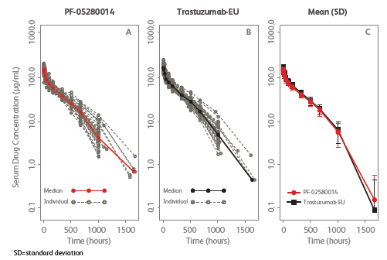
PF-05280014 Phase I: Pharmacokinetics
PF-05280014
Herceptin-EU
Mean (SD)
Ewesuedo R, et al. San Antonio Breast Cancer Symposium, December 10–14, 2013 (poster OT1–1–03)

Slide 9
PF-05280014 Phase I Safety
Treatment-Emergent Adverse Events Regardless of Causality Occurring in ≥5% of Total Subjects (Modified ITT Population)
 | PF-05280014 n = 35 | Herceptin®-EU n = 35 | Herceptin®-US n = 35
Subjects with any AE n (%) | 28 (80.0) | 29 (82.9) | 29 (82.9)
Eye disorders, n (%)
Conjunctival hyperemia | 4 (11.4) | 1 (2.9) | 2 (5.7)
Gastrointestinal disorders, n (%)
Diarrhea | 3 (8.6) | 2 (5.7) | 1 (2.9)
Nausea | 5 (14.3) | 5 (14.3) | 3 (8.6)
General disorders and administration site conditions, n (%)
Pyrexia | 10 (28.6) | 3 (8.6) | 2 (5.7)
Chills | 9 (25.7) | 7 (20.0) | 5 (14.3)
Fatigue | 3 (8.6) | 3 (8.6) | 3 (8.6)
Infections and infestations, n (%)
Nasopharyngitis | 3 (8.6) | 3 (8.6) | 2 (5.7)
Pharyngitis | 1 (2.9) | 4 (11.4) | 2 (5.7)
Injury, poisoning and procedural complications, n (%)
Infusion-related | 13 (37.1) | 10 (28.6) | 7 (20.0)
Musculoskeletal and connective tissue disorders, n (%)
Myalgia | 2 (5.7) | 2 (5.7) | 2 (5.7)
Nervous system disorders, n (%)
Headache | 10 (28.6) | 12 (34.3) | 8 (22.9)
Dizziness | 1 (2.9) | 4 (11.4) | 2 (5.7)
Respiratory, thoracic and mediastinal disorders, n (%)
Cough | 1 (2.9) | 4 (11.4) | 1 (2.9)
Yin D, et al. J Clin Oncol. 2013;31(Suppl): Abstract 612.

Slide 10
PF-05280014 Phase I trial Summary of Results
Similarity in terms of pharmacokinetic properties for PF-05280014 compared to both Herceptin® sourced from the US and Herceptin® sourced from the EU, and of trastuzumab-US compared to trastuzumab-EU for a single intravenous administration of the drugs.
Equivalent pharmacokinetic properties
Maximum observed serum concentration (C_{max})
Area under the curve (AUC) from day 1 to day 71
The three study drugs showed similar immunogenicity and safety profiles.

Slide 11
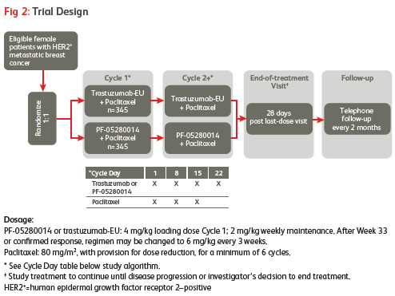
A Study of PF-05280014 [Trastuzumab-Pfizer] or Herceptin®-EU plus Paclitaxel in HER2 Positive First Line Metastatic Breast Cancer Treatment (REFLECTIONS B327-02)
690 patients (345/arm)
Ewesuedo R, et al. San Antonio Breast Cancer Symposium, December 10–14, 2013 (poster OT1–1–03)

Slide 12
Phase I/IIb Randomized Clinical Trial Comparing PK and Safety of Herceptin® and its Biosimilar CT-P6 in
Metastatic Breast Cancer
MBC, HER2 FISH+ with measurable disease, no prior trastuzumab and CT for MBC, > than 12 months from adjuvant/ neoadjuvant trastuzumab and CT
Screened
N = 332
Primary Endpoint:
Area under the curve at steady state (AUC_{ss})
Secondary Endpoint:
Trough concentration at steady state (C_{trough ss})
Tertiary Endpoints:
Average concentration (C_{av,ss})
Minimum concentration (C_{min})
Maximum concentration (C_{max})
Peak to trough fluctuation ratio (PTF)
Clearance at steady state (CL_{ss})
Terminal elimination rate constant (ʎ_{z})
Mean residence time at steady state (MRT_{ss})
Terminal half life (t _{½})
Apparent volume of distribution at steady state (Vz_{ss})
Safety Objectives: Cardiotoxicity, Infusion reaction /hypersensitivity
Randomized
N = 174
CT-P6 + paclitaxel
N = 86
Herceptin + paclitaxel
N = 88
Steady-state achieved
N = 51
Steady-state achieved
N = 49
Calculated AUC_{SS}
N = 48
Calculated AUC_{SS}
N = 49
Disease progression, death, or discontinuation
Im Y, et al. Presented at 13th St Gallen International Breast Cancer Conference; 13-16 March 2013; St Gallen, Switzerland. Poster 268.

Slide 13
Phase I/IIb Trial Comparing Herceptin® and its Biosimilar CT-P6 in MBC: Results
Multicenter trial: Korea, Russia, Ukraine, Latvia, Serbia
Parameter | Treatment | N | Geometric mean | % CV | Ratio (%) | 90% CI | P value
AUC_{SS} (μgh/mL) | CT-P6 | 48 | 32,000 | 43.5 | 104.57 | 93.64, 116.78 | .5029
 | Herceptin® | 49 | 30,600 | 30.9
C_{trough SS} (μg/mL) | CT-P6 | 51 | 19.5 | 37.0 | 101.35 | 87.94, 116.82 | .8754
 | Herceptin® | 49 | 19.2 | 39.6
Conclusions of the study:
CT-P6 demonstrated equivalent PK profile to Herceptin
CT-P6 well tolerated with a comparable safety profile to Herceptin
(infusion-related reaction, cardiotoxicity, and infection)
Im Y, et al. Presented at 13th St Gallen International Breast Cancer Conference; 13-16 March 2013; St Gallen, Switzerland. Poster 268.

Slide 14
Double-Blind, Randomized, Parallel Group, Phase III Study to Demonstrate Equivalence in Efficacy and Safety of CT-P6/Paclitaxel vs Herceptin®/Paclitaxel in MBC
COMPARE Trial:
CT-P6
+ paclitaxel q3w
HER2+ MBC
R
1:1
N = 244
N = 475
Herceptin®
+ paclitaxel q3w
Primary Endpoint: Overall response rate (ORR)
Inclusion Criteria:
MBC with measurable lesions
HER2 + IHC or FISH centrally confirmed
No prior trastuzumab and/or chemo Tx in metastatic setting
>12 months since prior adjuvant or neoadjuvant trastuzumab and/or chemo
ECOG 0 or 1
N = 231
Exclusion Criteria:
Prior chemo for MBC
CNS metastases
Baseline LVEF ≤50% or history of CHF
Im YH, et al. J Clin Oncol. 2013;31(Suppl): Abstract 629.
Notes:
References
Clinicaltrials.gov. Evaluate Safety, Efficacy and Pharmacokinetics (Compare). Available at: http://clinicaltrials.gov/ct2/show/NCT01084863?term=CT-P6&rank=1. Accessed February 2013.

Slide 15
Patient Characteristics | CT-P6 + Paclitaxel (n = 244) | Trastuzumab + Paclitaxel (n = 231)
Age (years)
Median (range) | 54 (31-75) | 53 (25-78)
≥65 years | 34 (13.9) | 22 (9.5)
<65 years | 210 (86.1) | 209 (90.5)
Ethnicity, no (%)
Caucasian | 158 (64.8) | 141 (61.0)
Asian | 86 (35.2) | 90 (39.0)
Prior neoadjuvant or adjuvant therapy, n (%) | 130 (53.3) | 121 (52.4)
Trastuzumab | 8 (3.3) | 8 (3.5)
Taxane | 33 (13.5 | 31 (13.4)
Anthracycline | 111 (45.5) | 106 (45.9)
Baseline ECOG PS score, n (%)
Score 0 | 128 (52.5) | 116 (50.2)
Score 1 | 115 (47.1) | 115 (49.8)
Disease status
Initial metastatic | 90 (36.9) | 84 (36.4)
Recurrence | 154 (63.1) | 147 (63.6)
Disease-free interval, months (range) | 23.8 (0.9-148.2) | 20 (0.5-384.9)
Im YH, et al. J Clin Oncol. 2013;31(Suppl): Abstract 629.

Slide 16
Safety
 | CT-P6 + Paclitaxel |  | Herceptin® + Paclitaxel |  | P value
 | All | ≥G3 | All | ≥G3 | All | ≥G3
Total serious adverse events | 33 | 28 | 28 | 24 | .6477 | .7048
All adverse events | 224 | 110 | 214 | 107 | .7336 | .7865
Hematologic events
Anemia | 187 | 10 | 180 | 4 | .7388 | .1274
Neutropenia | 142 | 81 | 140 | 82 | .5931 | .5975
Im YH, et al. J Clin Oncol. 2013;31(Suppl): Abstract 629.

Slide 17
Nonhematologic Adverse Events
 | CT-P6 + Paclitaxel |  | Trastuzumab + Paclitaxel |  | P Value
 | All | ≥G3 | All | ≥G3 | All | ≥G3
Cardiotoxicity | 15 | 6 | 14 | 3 | .9684 | .3539
Hypersensitivity | 118 | 11 | 127 | 11 | .1492 | .8954
Peripheral neuropathy
Sensorimotor | 4 | 3 | 5 | 1 | .6748 | .3423
Sensory | 48 | 7 | 50 | 4 | .5954 | .4101
Unspecified | 63 | 14 | 56 | 13 | .6917 | .9587
Nausea / Vomiting | 48 | 2 | 44 | 2 | .8633 | .9561
Fatigue and/or Asthenia | 73 | 5 | 63 | 3 | .5238 | .5252
Diarrhea | 34 | 1 | 41 | 1 | .2545 | .9690
Stomatitis | 14 | 0 | 16 | 0 | .5945 | NE
Alopecia | 122 | 0 | 127 | 3 | .2775 | .0741
Myalgia | 47 | 1 | 52 | 2 | .3836 | .5307
Pain in extremity | 22 | 2 | 29 | 6 | .2132 | .1323
Arthralgia | 21 | 0 | 30 | 0 | .1232 | NE
Infections | 57 | 10 | 46 | 8 | 0.3622 | .7171
Im YH, et al. J Clin Oncol. 2013;31(suppl): Abstract 629.

Slide 18
Compare: Overall Response Rate
 | ITRC |  | Investigator
 | CT-P6 + Paclitaxel (n = 244) | Herceptin® + Paclitaxel (n = 231) | CT-P6 + Paclitaxel (n = 244) | Herceptin® + Paclitaxel (n = 231)
Complete response | 9 (3.7%) | 4 (1.7%) | 12 (4.9%) | 6 (2.6%)
Partial response | 129 (52.9%) | 139 (60.2%) | 146 (59.8%) | 152 (65.8%)
Stable disease | 49 (20.1%) | 38 (16.5%) | 61 (25.0%) | 56 (24.2%)
Overall response rate | 138 (56.6%) | 143 (61.9%) | 158 (64.8%) | 158 (68.4%)
Difference, % [95% CI] | 5.4 [-14.3, 3.6] |  | 3.6 [-12.6, 5.4]
 |  | Difference, % (95% CI %)
ITRC FAS |  | 5.4 (-14.3, 3.6)
ITRC PPS |  | 5.0 (-14.1, 4.1)
Investigator FAS |  | 3.6 (-12.6, 5.4)
Investigator PPS |  | 3.2 (-12.3, 5.9)
-15 -10 -5 0 5 10 15
Favors Herceptin®
Favors CT-P6
FAS, Full analysis set; PPS, per protocol patient set
Difference in proportion of complete response or partial response. Confidence interval estimated using the exact method.
Im YH, et al. J Clin Oncol. 2013;31(Suppl): Abstract 629.

Slide 19
Compare: Time to Progression
Time to progression in the responder group by independent review committee (full analysis set, 1 year data)
1.0 –
0.8 –
0.6 –
0.4 –
0.2 –
0.0 –
P = .0978
Probability
CT-P6 + Paclitaxel, 11.07 months
Herceptin® + Paclitaxel, 12.52 months
0 1 2 3 4 5 6 7 8 9 10 11 12 13 14
Months
Safety
CT-P6 was well tolerated with a safety profile comparable to Herceptin
No immunogenicity data available
Im YH, et al. J Clin Oncol. 2013;31(Suppl): Abstract 629.

Slide 20
CT-P6 in Metastatic Breast Cancer Summary of Results
CT-P6 (trastuzumab biosimilar) is similar to Herceptin® in terms of pharmacokinetic properties, safety and efficacy

Slide 21
What is the most “Sensitive and Homogenous Population” in Breast Cancer?
Biosimilar monoclonal antibodies should be studied in the population of patients in whom, if there is a difference between the biosimilar and the reference product, that difference will most easily be detected.
This population will vary for each antibody and each disease in which the antibody is used
With biosimilar trastuzumab, the most sensitive population is early-stage breast cancer in the neoadjuvant setting

Slide 22
The neoadjuvant setting is the most sensitive population to study similarity of Herceptin® and Trastuzumab biosimilar
Topic | Metastatic Population | Neoadjuvant population
PK | ✗ Affected by patient’s health status & tumor burden | Homogeneous population can be selected ✗ Variability is also observed
PD | ✗ Clinically validated PD marker not available
Clinical efficacy/safety | ✗ Difficult to select homogeneous group Need to control and stratify for multiple factors (e.g., prior use of chemotherapy, performance status) Population with heterogeneous characteristics affecting final clinical outcome | ✓ Populations less likely to be confounded by baseline characteristics and external factors Sub-group of patients with higher responses could be identified (eg, hormone-receptor negative patients)
Immunogenicity | ✗ Immune system affected by performance status and concomitant chemotherapies received | ✓ Immune system impaired during chemotherapy cycles, but likely to recover to normal status thereafter

Slide 23
Phase III Trials of Neoadjuvant Trastuzumab Biosimilars in Early-Stage Breast Cancer
 | SB-3 (Samsung Bioepis) | ABP-980 (Amgen) | CT-P6 (Celltrion)
Trial identifier | NCT02149524 | NCT01901146 | NCT02162667
Trial design | Randomized double-blind | Randomized double-blind | Randomized double-blind
Comparator | Herceptin® | Herceptin® | Herceptin®
Disease | EBC | EBC | EBC
Chemo | ? | Epirubicin, Cyclophosphamide, Paclitaxel | docetaxel followed by FEC (5-fluorouracil, epirubicin and cyclophosphamide)
Primary Endpoint | pCR (breast) | pCR (breast) | pCR (breast/LN)
No of pts | 498 | 556 | 532
Status | Ongoing | Ongoing | Planning to start in 2014
www.clinicaltrials.gov, accessed 11/2/14
Notes:
Update this trial with info from paper

Slide 24
Is Extrapolation across Indications Possible using Trastuzumab Biosimilars?
Trastuzumab is used in different ways across tumor types and disease settings
In combination with different chemotherapies, Pertuzumab, hormonal therapies, and as single agent (maintenance)
Neoadjuvant and adjuvant Herceptin® in breast cancer
Herceptin® in metastatic breast cancer
Herceptin® in metastatic gastric cancer

Slide 25
Challenges to Incorporate Trastuzumab Biosimilars into Breast Cancer Care
Residual uncertainties and differences
Lack of reliable disease and product specific PD markers and complex non-linear pharmacokinetics
Conflicting and inconsistent historical clinical data with the reference product (e.g., variable ORR or pCR rates with Herceptin)
Extrapolation issues
Regulatory and prescribers’ hesitation
Difficulties in extrapolation of safety and long-term immunogenicity
Operational execution of global clinical studies

Slide 26
Conclusions
Biosimilar ≠ Identical
Phase III randomized trials of trastuzumab biosimilars are ongoing (global studies)
Incorporation of trastuzumab biosimilars into breast cancer care will require equivalence trials in the metastatic and early-stage settings
The neoadjuvant setting provides the most sensitive and homogeneous population
How trastuzumab biosimilars are tested in clinical trials will determine how they are used in the clinic

Slide 27


Thank You!
Francisco.Esteva@nyumc.org

